Slide 1
JOINS & VIEWS

Slide 2
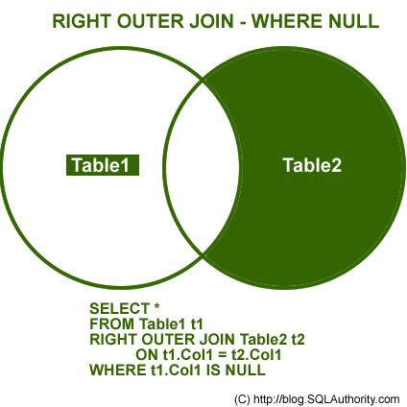
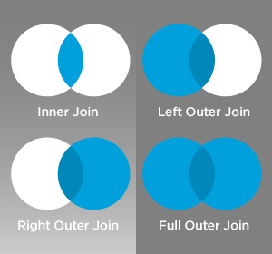
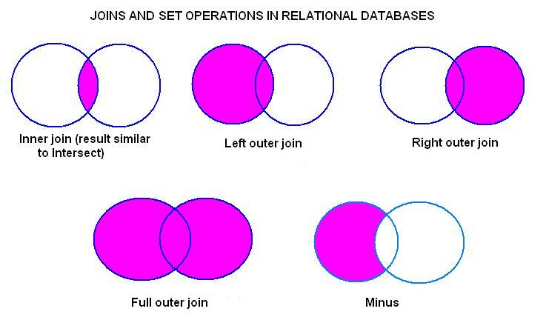
JOINS
Natural join
Inner join
Outer join
Cross join
Equi join/Non equi join/Theta Join
Self join

Slide 3
Theta Join
When Theta join uses only equality comparison operator it is said to be Equi-Join. The above example corresponds to equi-join.
θ in Theta join is the join condition. Theta joins combines tuples from different relations provided they satisfy the theta condition.
Natural Join
Natural join does not use any comparison operator. It does not concatenate the way Cartesian product does. Instead, Natural Join can only be performed if the there is at least one common attribute exists between relation. Those attributes must have same name and domain.
Inner Join
Theta Join, Equi Join and Natural Join are called inner-joins. An inner-join process includes only tuples with matching attributes, rest are discarded in resulting relation.

Slide 4
Self Joins
create table teacher121
(
id int,
name varchar2(15),
hod int)
SELECT a.name "teacher",'works under', c.name "cod" from teacher121 a, teacher121 c where a.hod=c.id;

Slide 5
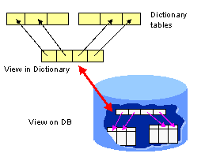
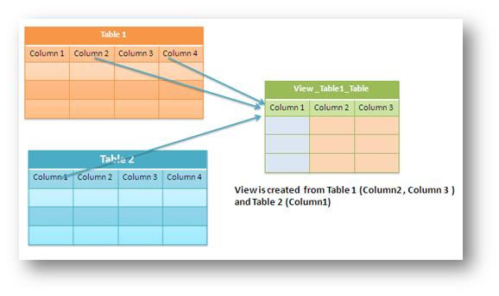
View
View
Dynamic result of one or more relational operations operating on base relations to produce another relation.
Virtual relation that does not necessarily actually exist in the
database but is produced upon request, at time of request.

Slide 6
Syntax
SQL - CREATE VIEW
CREATE VIEW ViewName [ (newColumnName
[,...]) ]
AS subselect
[WITH [CASCADED | LOCAL] CHECK
OPTION]
• Can assign a name to each column in view.
• If list of column names is specified, it must
have same number of items as number of
columns produced by subselect.
• If omitted, each column takes name of
corresponding column in subselect.

Slide 7
Create view so that manager at branch
B003 can only see details for staff who
work in his or her office.
CREATE VIEWManager3Staff
AS SELECT *
FROMStaff
WHERE branchNo = ‘B003’;

Slide 8
Create view of staff details at branch B003 excluding salaries.
CREATE VIEWStaff3
AS SELECT staffNo, fName, lName, position, sex
FROM Staff
WHERE branchNo = ‘B003’;

Slide 9
Grouped and Joined Views
Create view of staff who manage properties for rent, including branch
number they work at, staff number, and number of properties they manage.
CREATE VIEW StaffPropCnt (branchNo, staffNo, cnt)
AS SELECT s.branchNo, s.staffNo, COUNT(*)
FROM Staff s, PropertyForRent p
WHERE s.staffNo = p.staffNo
GROUP BY s.branchNo, s.staffNo;

